Slide 1
advertising
marketing

Slide 2
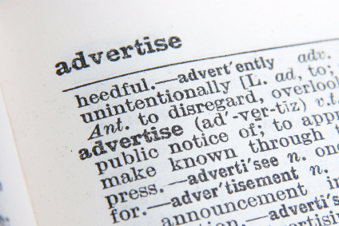
What are advertisments for
Advertise, advertisment, advert, ad, advertising, advertiser
Commercial, classified
Blurb, Tv add, puffery, soft sell/hard sell, spam
(Meals fit for a king!, watch out for pop-up spams selling spam blockers)
Advertising agency

Slide 3
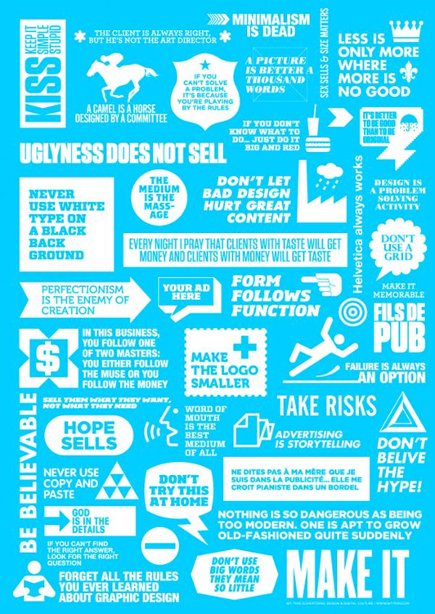
Good advertising
Humour
Special effects
Motivation
Celebrities, beauty, attraction
Grabbing attention, intrigue
Memorable, understandable
Good idea

Slide 4
Other effective means for a good advert
High visual magnetism
Select the right audience
Promise a reward
Be easy to read
Make it memorable
Intrigue
Emotion
Association (I can relate to that)
Identify a problem
Make a claim

Slide 5
Effective language
Superlatives, intensifiers
Quality
Absolutely, by far, immediately, gigantic, highest
Attractive, exclusive, unique, revolutionary,
Tempting, must-have
Excellent, fabulous, extraordinary, sensational
Save, health, you, results, sex
Quality, reliable, tested, proven, profitable, safety
Bargain, discount
Guaranteed, unconditional
Valuable, useful, sustainable, helpful, powerful, practical

Slide 6
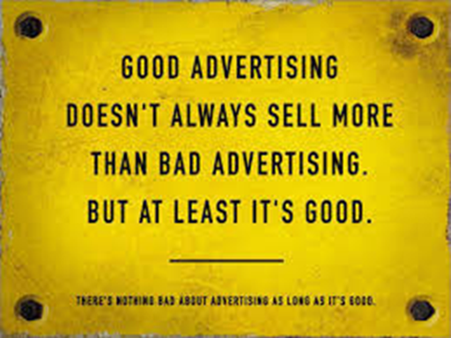
Your favourite ad
Target group
Means to attract customers
Language
What do you like about it?
Do you respond to advertising?

Slide 7
Watch these videos
https://www.youtube.com/watch?v=I9Y4eYHzFKo
https://www.youtube.com/watch?v=XYz3sl0LEA4

